Slide 1
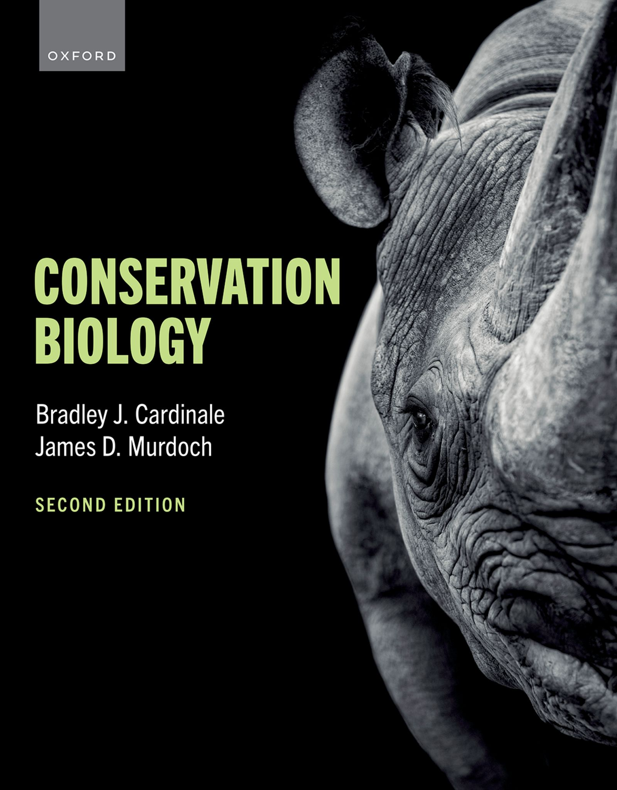
CONSERVATION BIOLOGY
By Bradley J. Cardinale and James D. Murdoch

Slide 2
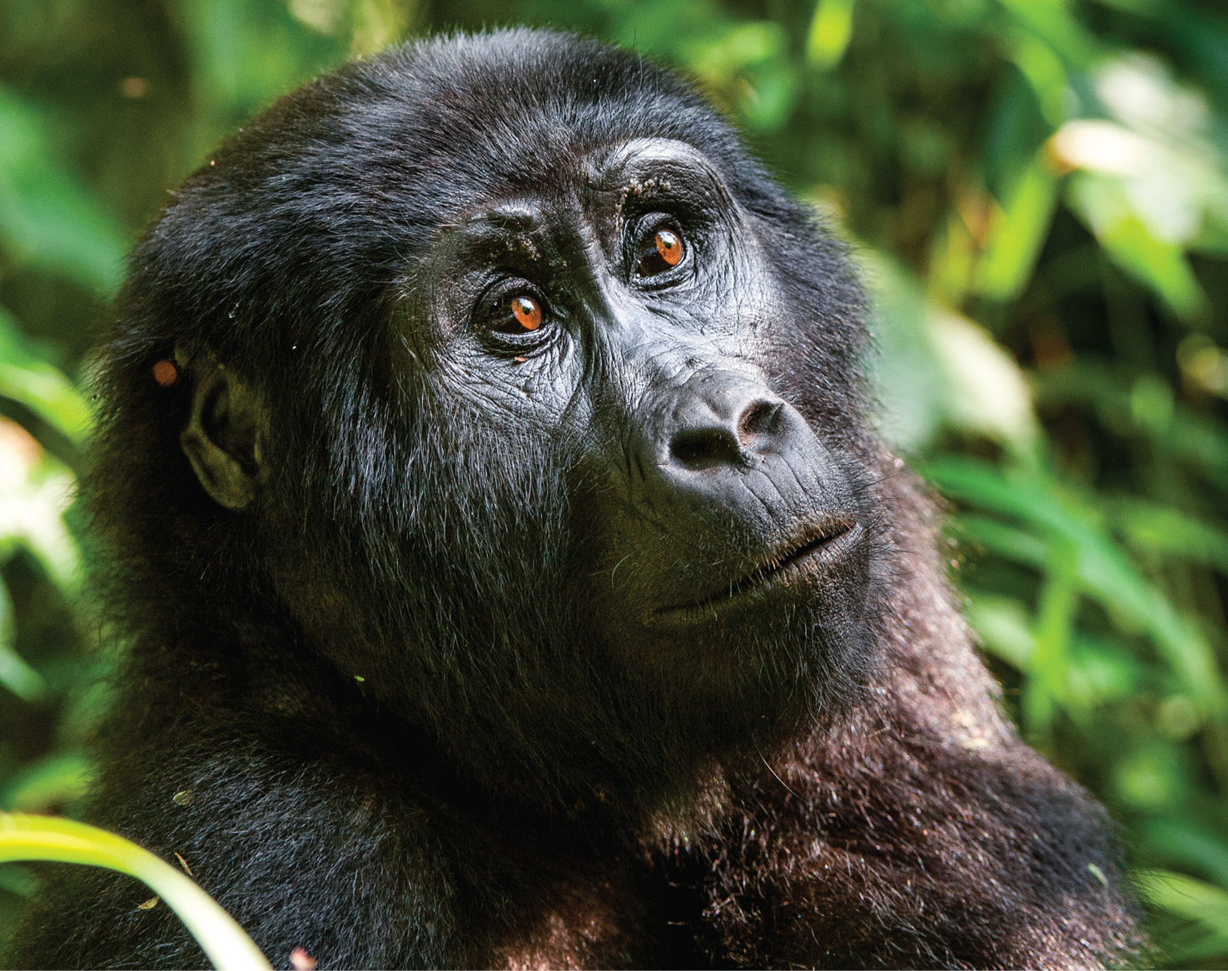
2
Notes:
Gorillas (Gorilla beringei and Gorilla gorilla) are the largest members of the primate family and are closely related to humans, sharing 98% of their DNA. Female gorillas give birth only once every four years at best, which means the loss of even a few individuals from a group can drastically reduce the long-term survival of a gorilla troop. Unfortunately, gorillas are a Critically Endangered species as a result of habitat encroachment and poaching for bushmeat.

Slide 3
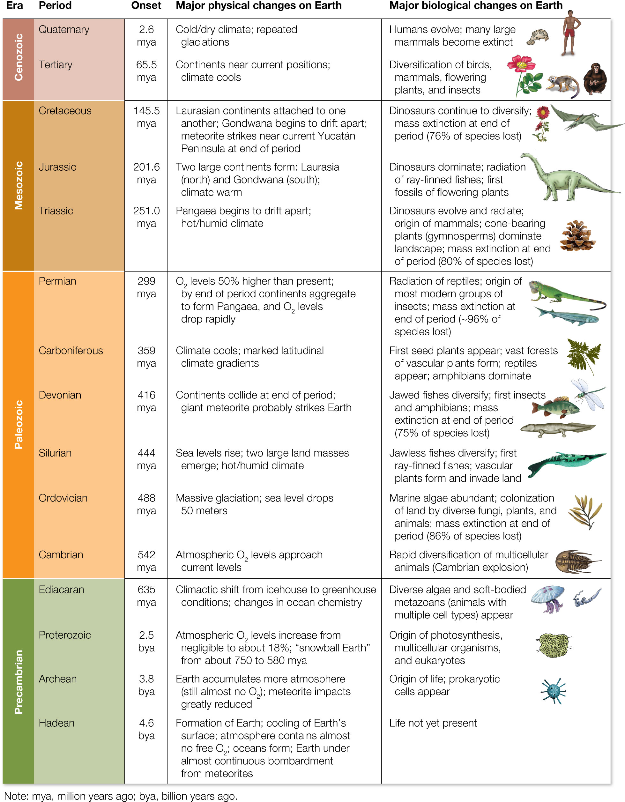
Figure 4.1 A geological and ecological history of life on Earth, starting with the formation of the planet some 4.6 billion years ago.
Notes:
Figure 4.1 A geological and ecological history of life on Earth, starting with the formation of the planet some 4.6 billion years ago.

Slide 4
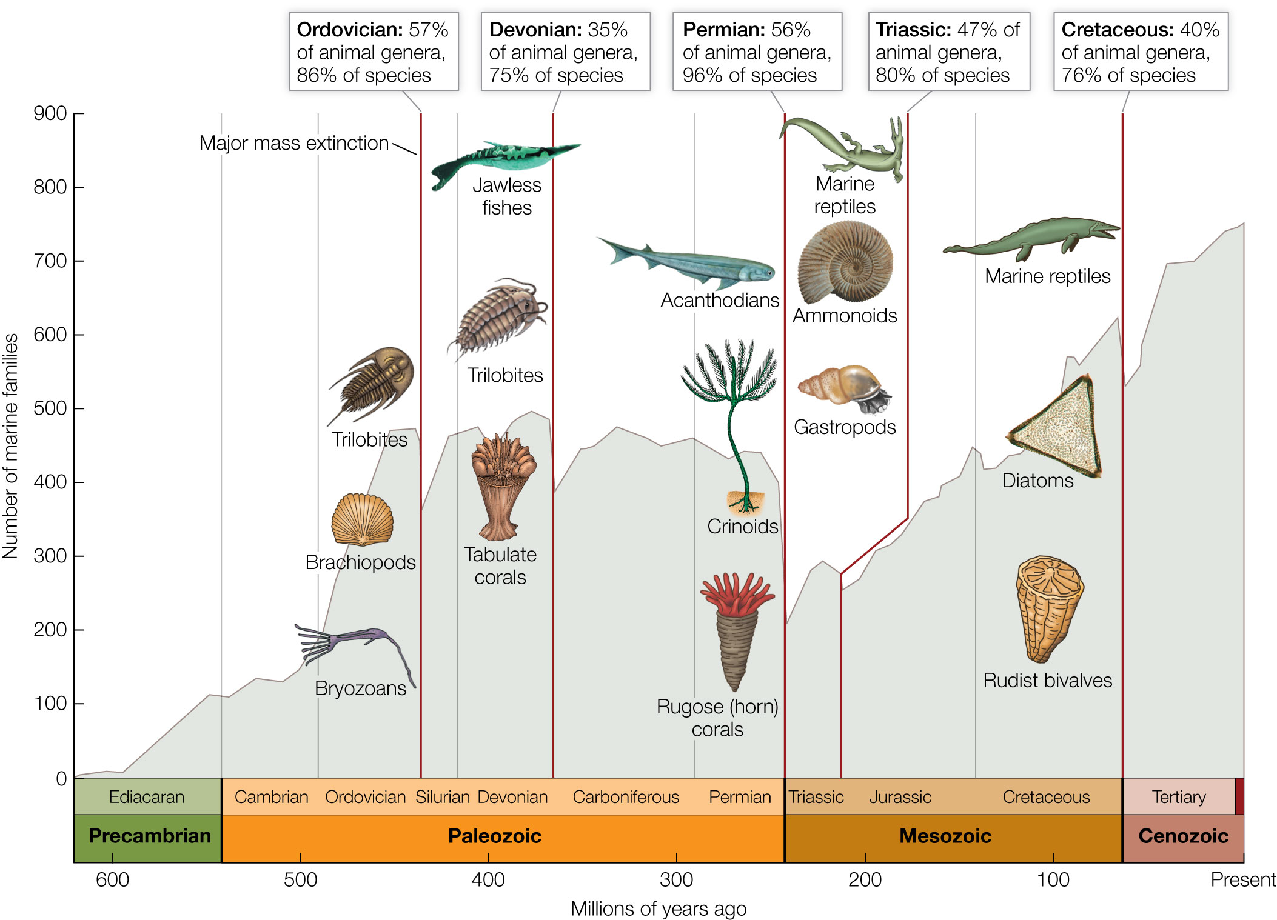
Figure 4.2 The diversity of marine animal families through geologic time, as measured in the fossil record.
Notes:
Figure 4.2 The diversity of marine animal families through geologic time, as measured in the fossil record. The Big Five mass extinction events are noted at the top, showing the percentage of animal genera and of all species that went extinct during that event. Images provide examples of some of the marine animals impacted by these mass extinction events

Slide 5
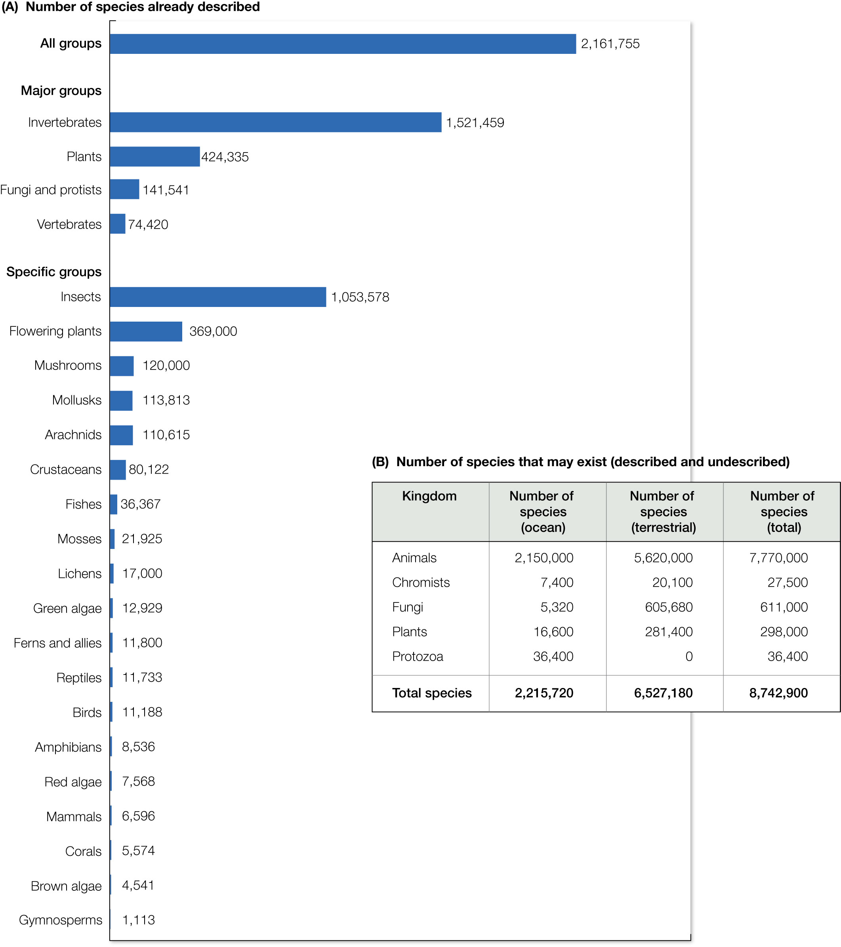
Figure 4.3 (A) About 2.16 million eukaryotic species have now been identified and described by scientists. The majority of these are eukaryotic animals and plants.
Notes:
Figure 4.3 (A) About 2.16 million eukaryotic species have now been identified and described by scientists. The majority of these are eukaryotic animals and plants. (B) Recent estimates suggest that most eukaryotic species have yet to be discovered because there may be as many as 8.74 million plants, animals, fungi, chromists, and protozoa on Earth. In addition to eukaryotes, somewhere between a billion and a trillion types of prokaryotes (archaea and bacteria) are still unknown to science.

Slide 6
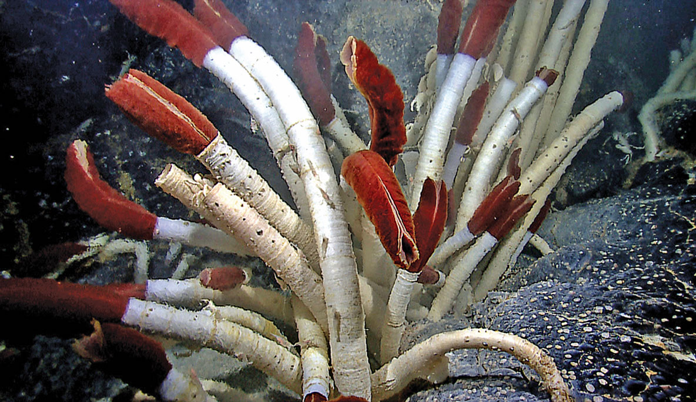
6
Notes:
Deep-sea tubeworms (Pogonophora) living on hydrothermal vents on the ocean floor led to the discovery of bacterial chemosynthesis, which is a way to fix carbon and make biological tissue without sunlight.

Slide 7
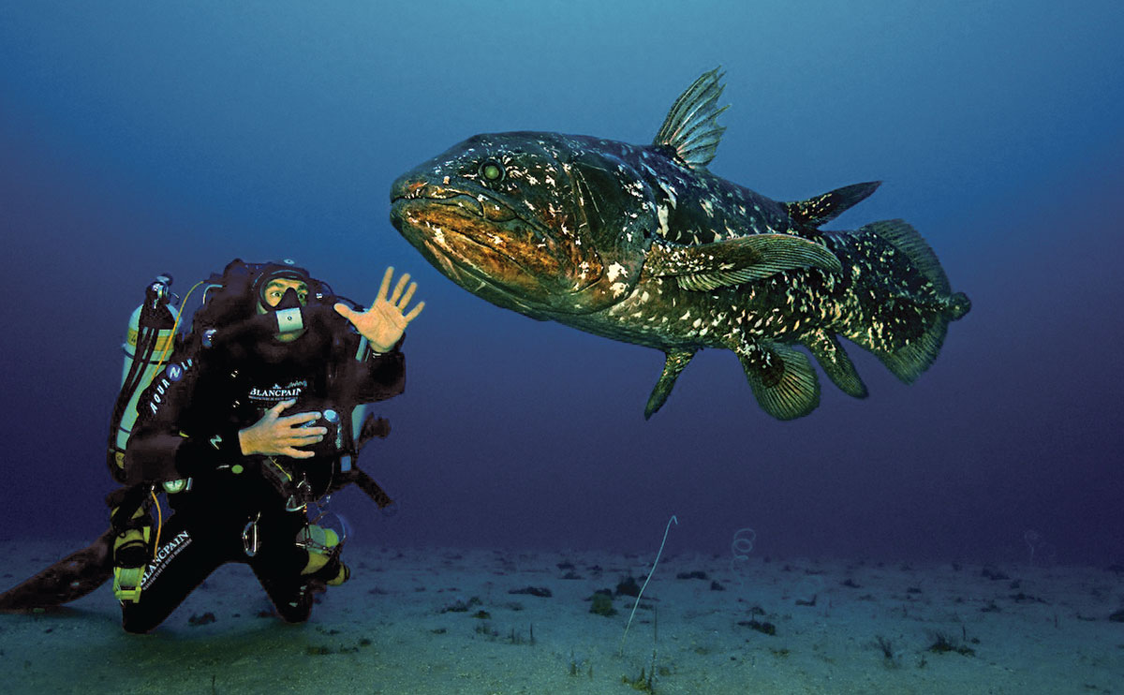
7
Notes:
The coelacanth (Latimeria chalumnae), which was thought to have gone extinct 65 million years ago, was rediscovered in the Indian Ocean in 1938.

Slide 8
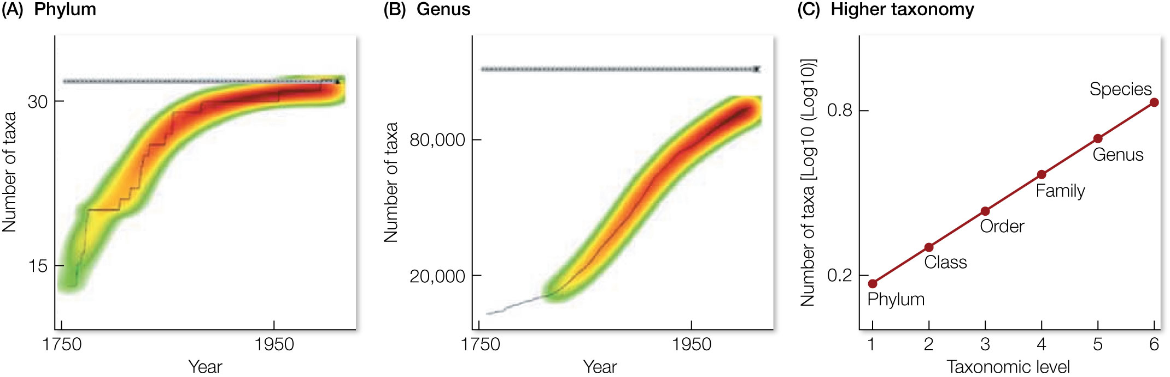
Figure 4.4 Predicting the global number of species of animals from their higher taxonomy.
Notes:
Figure 4.4 Predicting the global number of species of animals from their higher taxonomy. (A) The number of new phyla discovered reached a plateau about 1950. However, (B) the number of new genera being discovered is still going up. This means we don’t know for sure how many genera there are. However, (C) for well-studied groups of organisms that have been fully described, there is a predictable relationship between diversity at the level of phyla and diversity at the level of genera. Using this relationship, scientists can estimate how many genera are likely to exist for less-studied groups.

Slide 9
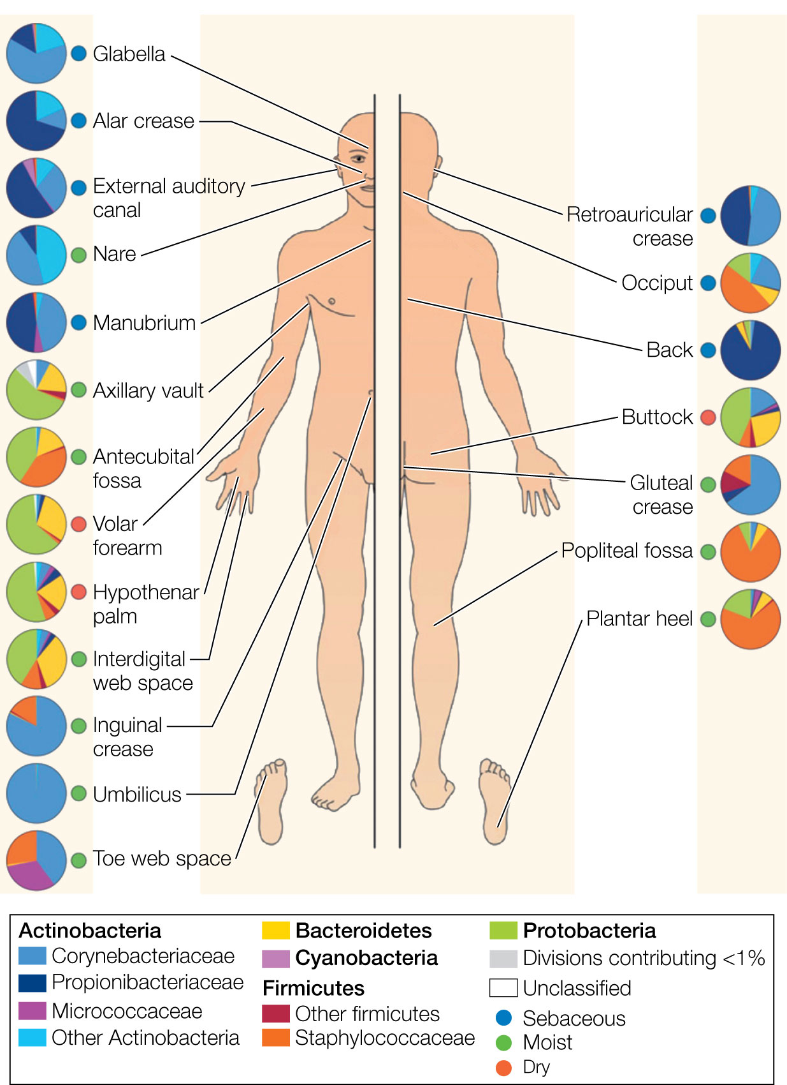
9
Notes:
The Human Microbiome Project has shown that the human body is an ecosystem that hosts more than 10,000 unique types of bacteria. Bacterial cells on the human body outnumber human cells almost three to one.

Slide 10
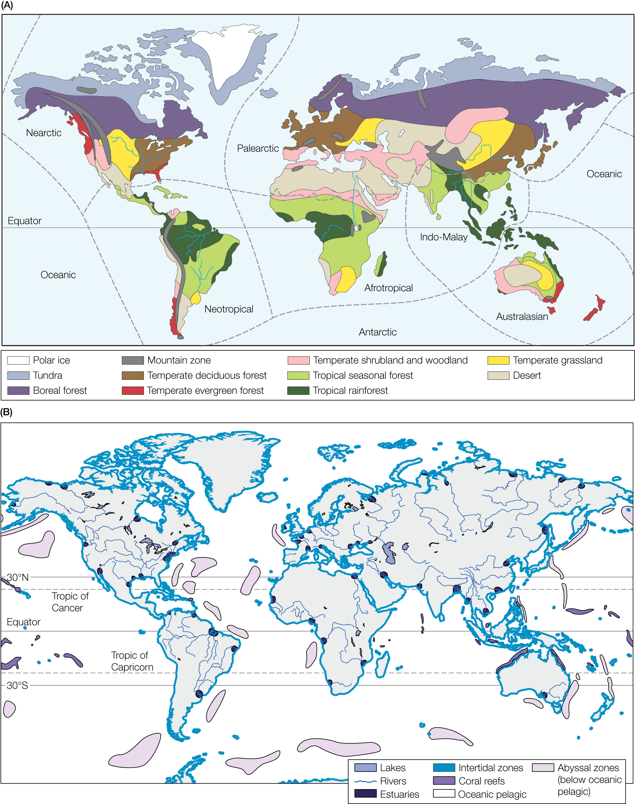
Figure 4.5 Realms and biomes. (A) The globe divided into Earth’s major biogeographic realms and terrestrial biomes. (B) Common marine and freshwater biomes.
Notes:
Figure 4.5 Realms and biomes. (A) The globe divided into Earth’s major biogeographic realms and terrestrial biomes. (B) Common marine and freshwater biomes.

Slide 11
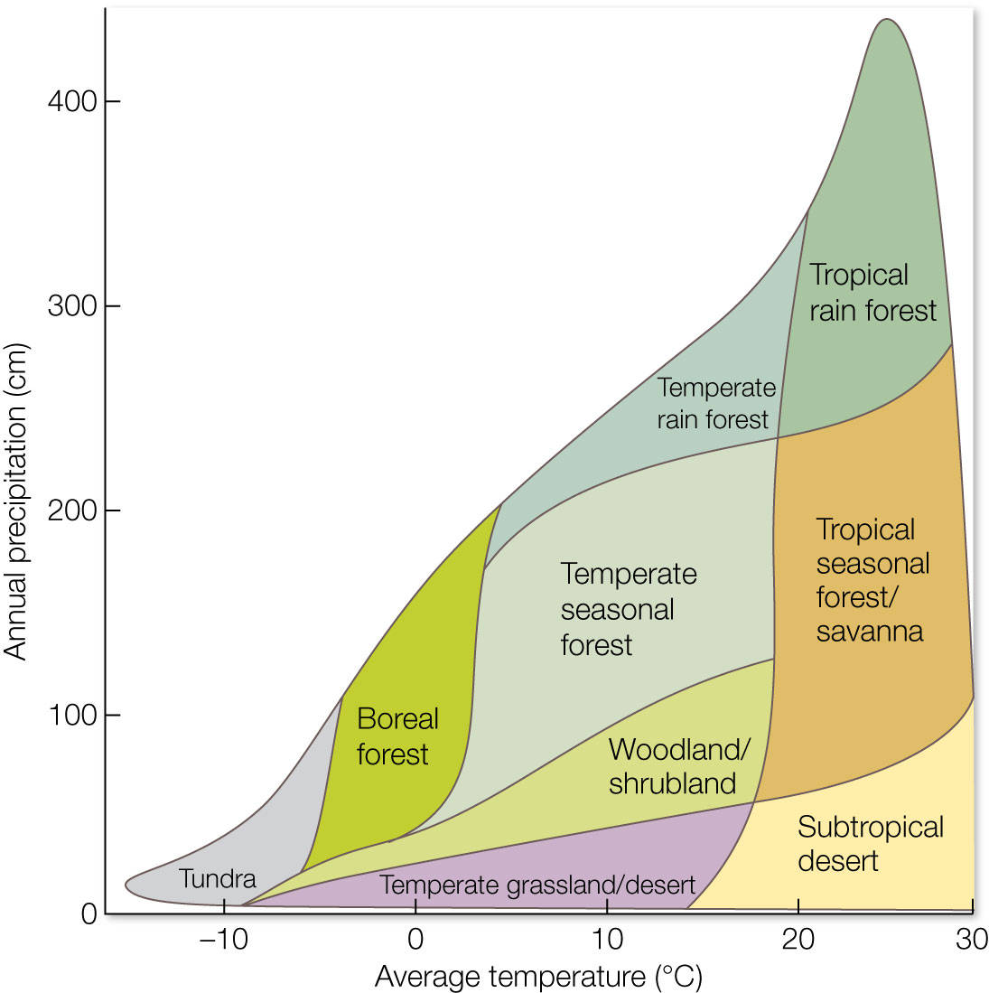
Figure 4.6 Terrestrial biomes, which are defined by dominant types of plant communities, change predictably along environmental gradients such as temperature (x axis) and precipitation (y axis).
Notes:
Figure 4.6 Terrestrial biomes, which are defined by dominant types of plant communities, change predictably along environmental gradients such as temperature (x axis) and precipitation (y axis). Note that if you know the temperature and precipitation for any location on Earth, or you can predict what temperature and precipitation may be in the future, then you can likely predict the type of biome and vegetation that will be there. This is useful, for example, when predicting how dominant types of vegetation, and communities of species, will respond to human stressors such as climate change.

Slide 12
TABLE 4.1 Numbers of endemic species of plants, birds, mammals, reptiles, and amphibians in regions that have exceptional degrees of endemismª
Region | Size (%)^{b} | Plants | Birds | Mammals | Reptiles | Amphibians
Tropical Andes | 314,500 (25) | 20,000 | 677 | 68 | 218 | 604
Mesoamerica | 231,999 (20) | 5,000 | 251 | 210 | 391 | 307
Caribbean | 29,840 (11) | 7,000 | 148 | 49 | 418 | 164
Atlantic Forest of Brazil | 91,930 (7.5) | 8,000 | 181 | 73 | 60 | 253
Choco/Darien/Western Ecuador | 16,471 (24) | 2,250 | 85 | 60 | 63 | 210
Cerrado of Brazil | 356,630 (20) | 4,400 | 29 | 19 | 24 | 45
Madagascar | 59,038 (10) | 9,704 | 199 | 84 | 301 | 187
West African forests | 126,500 (10) | 2,250 | 90 | 45 | 46 | 89
Cape Floristic Province | 18,000 (24) | 5,682 | 6 | 9 | 19 | 19
Mediterranean Basin | 110,000 (5) | 13,000 | 47 | 46 | 110 | 32
Sundaland | 125,000 (8) | 15,000 | 139 | 115 | 268 | 179
Wallacea | 52,020 (15) | 1,500 | 249 | 123 | 122 | 35
Philippines | 9,023 (3) | 5,832 | 183 | 111 | 159 | 65
Indo-Burma | 100,000 (5) | 7,000 | 140 | 73 | 201 | 114
South-central China | 64,000 (8) | 3,500 | 36 | 75 | 16 | 51
Western Ghats/ Sri Lanka | 12,450 (7) | 2,180 | 40 | 38 | 161 | 116
Southwest Australia | 33,336 (11) | 4,331 | 19 | 7 | 50 | 24
Polynesia/Micronesia | 10,024 (22) | 3,334 | 174 | 9 | 37 | 3
Source: Data from N. Myers et al. 2000. Nature 403: 853–858.
ª1% or greater of global total for endemic plants or vertebrates.
^{b}Size (%) refers to remaining primary vegetation (in square kilometers) and to percentage remaining of original extent.
Notes:
TABLE 4.1 Numbers of endemic species of plants, birds, mammals, reptiles, and amphibians in regions that have exceptional degrees of endemismª

Slide 13
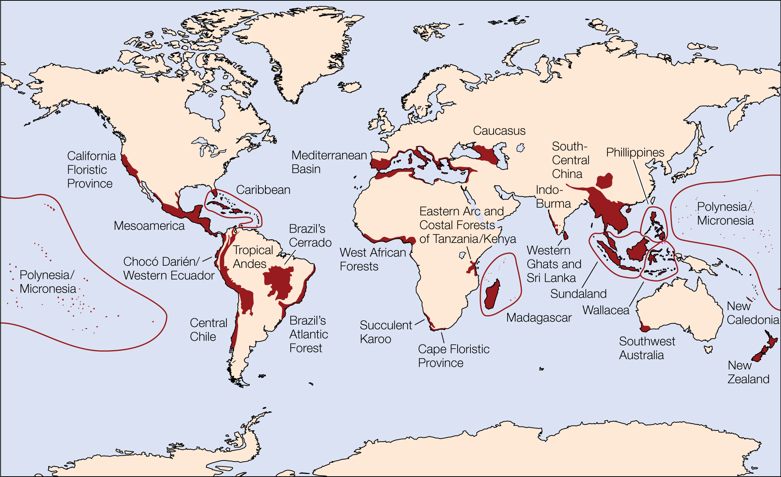
Figure 4.7 Biodiversity is unequally distributed across the planet.
Notes:
Figure 4.7 Biodiversity is unequally distributed across the planet. This map shows Myers et al.’s46 original 25 hotspots of biodiversity (in red shading) that contain 44% of all species of vascular plants and 35% of all vertebrate species in areas that comprise just 1.4% of the land surface of the Earth. More refined maps of hotspots are discussed in Chapter 14.

Slide 14
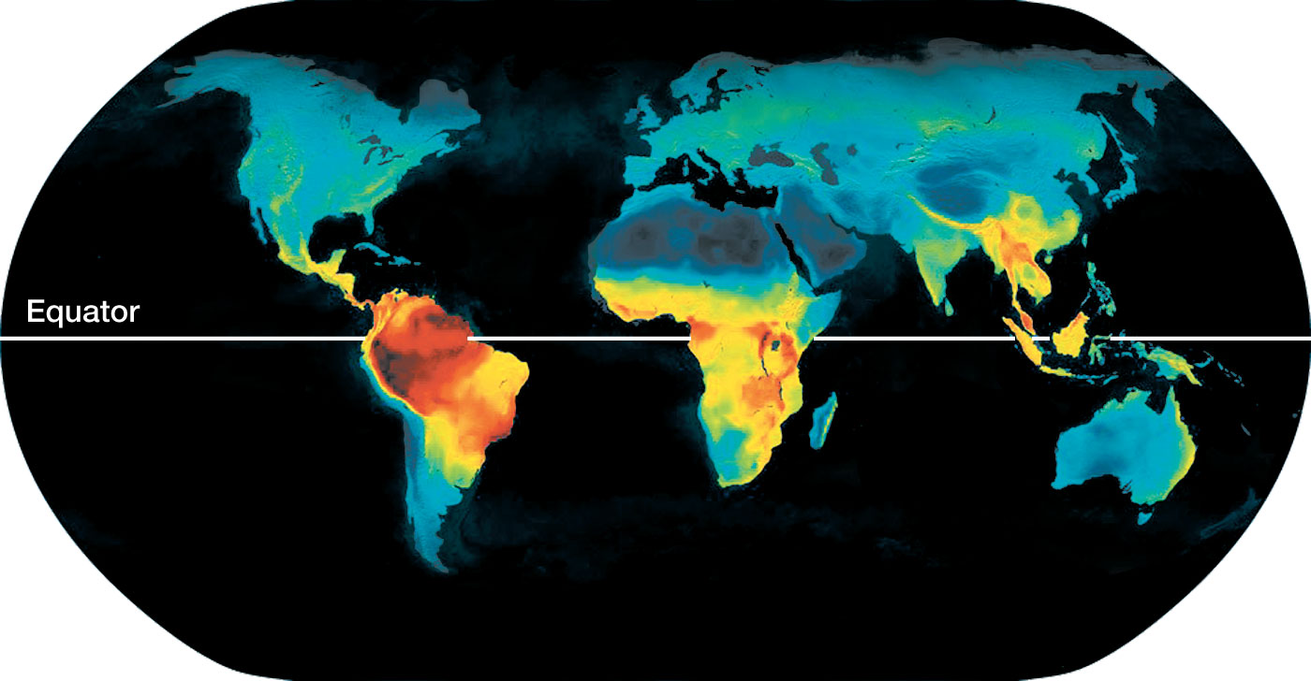
Figure 4.8 As is true for most groups of organisms, vertebrate animals follow a latitudinal gradient; species richness increases from the poles to the equator.
Notes:
Figure 4.8 As is true for most groups of organisms, vertebrate animals follow a latitudinal gradient; species richness increases from the poles to the equator. In this figure, warmer colors (yellow, orange, and red) represent more diversity, while cooler colors (green and blue) represent less diversity.

Slide 15
TABLE 4.2 Number of native mammal species in selected tropical and temperate countries paired for comparable size
Tropical country | Area (1,000 km²) | Number of mammal species | Temperate country | Area (1,000 km²) | Number of mammal species
Brazil | 8,512 | 394 | Canada | 9,220 | 193
DRCª | 2,345 | 450 | Argentina | 2,777 | 320
Mexico | 1,972 | 491 | Algeria | 2,382 | 92
Indonesia | 1,919 | 515 | Iran | 1,648 | 140
Colombia | 1,139 | 359 | South Africa | 1,185 | 247
Venezuela | 912 | 323 | Chile | 751 | 91
Thailand | 514 | 265 | France | 544 | 93
Philippines | 300 | 153 | United Kingdom | 245 | 50
Rwanda | 26 | 151 | Belgium | 30 | 58
Source: B. Groombridge and M. D. Jenkins 2010. World Atlas of Biodiversity: Earth’s Living Resources in the 21st Century,
pp. 296–305, Berkeley, CA: University of California Press.
ªDRC = Democratic Republic of the Congo.
Notes:
TABLE 4.2 Number of native mammal species in selected tropical and temperate countries paired for comparable size

Slide 16
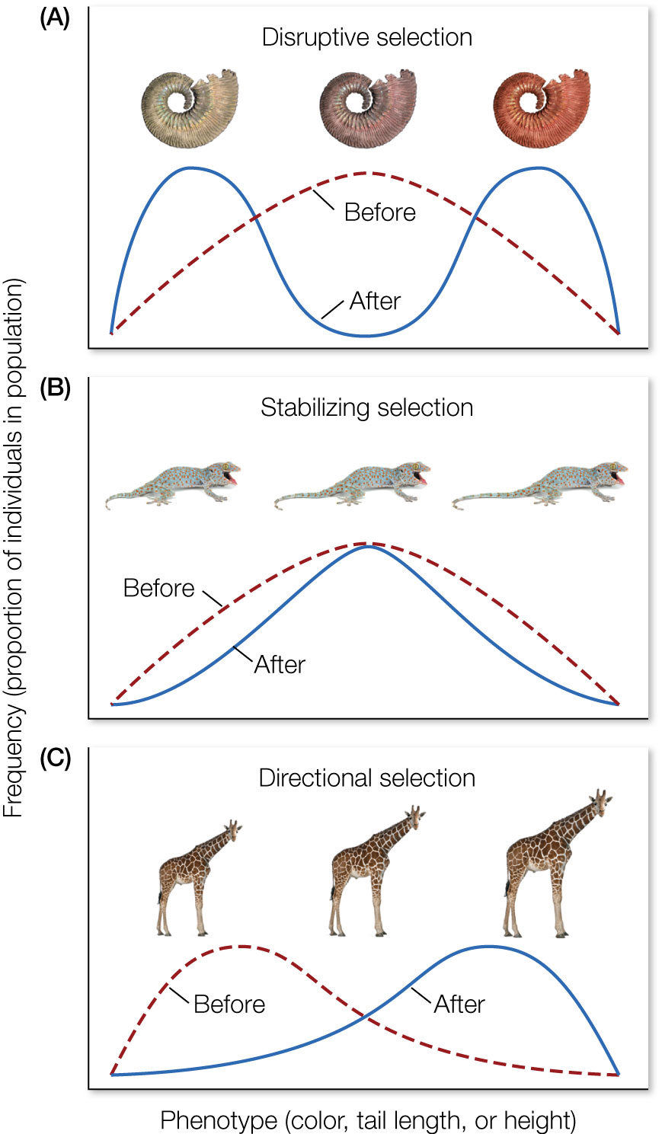
Figure 4.9 Natural selection can cause organisms to change in several possible ways. In disruptive selection
Notes:
Figure 4.9 Natural selection can cause organisms to change in several possible ways. In disruptive selection (A), the selective force reduces fitness of the average phenotype (dashed red line labeled “before”), causing the population to evolve into different phenotypes (solid blue line labeled “after”). In stabilizing selection (B), the selective force reduces the fitness of the extreme phenotypes, forcing the population to evolve toward the average (average tail length). In directional selection (C), the selective force reduces the fitness of one phenotype in the population, forcing the distribution in the direction of an alternative phenotype (larger neck size).

Slide 17
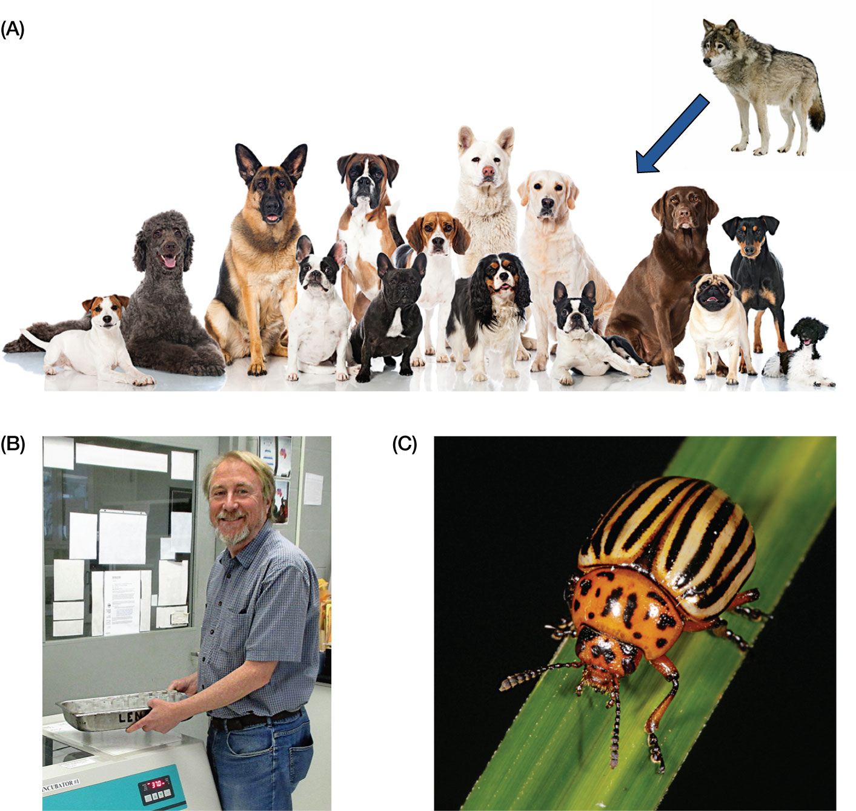
Figure 4.10 Examples of evolution by natural selection.
Notes:
Figure 4.10 Examples of evolution by natural selection. (A) In our own backyards, humans have selectively bred dogs for a variety of desired traits, all of which originally came from a wolf ancestor. (B) In the lab, biologists have tracked the accrual of genetic mutations and documented natural selection in bacteria. (C) In nature, pests like the Colorado potato beetle have developed resistance to pesticides.

Slide 18
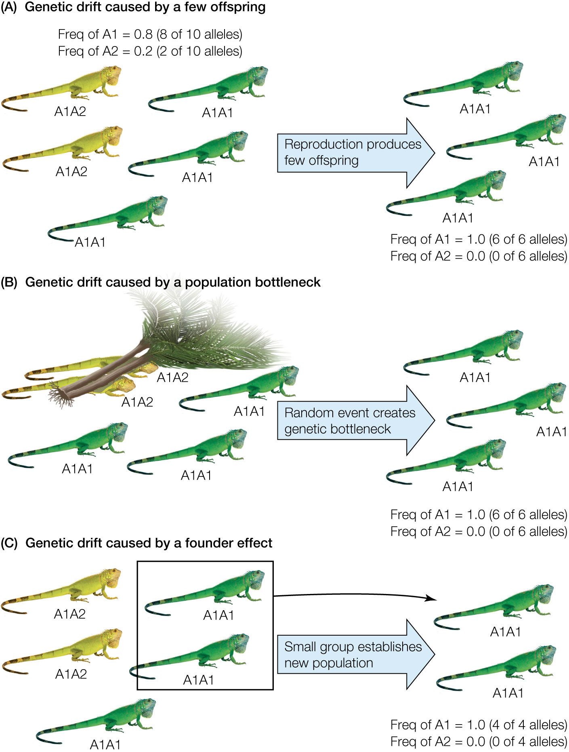
Figure 4.11 Evolution by genetic drift. In a population of lizards, color morphology is controlled by two alleles, A1 and A2.
Notes:
Figure 4.11 Evolution by genetic drift. In a population of lizards, color morphology is controlled by two alleles, A1 and A2. The frequency of these alleles can change at random if (A) a small population produces few offspring and one of the two alleles (here A2) is lost from the population by random chance; (B) part of the small population is accidentally killed by a random event (e.g., a treefall), creating a population bottleneck that eliminates certain alleles; or (C) a subset of the population colonizes a new location and forms a new colony. If this subset is not representative of the original diversity of the population, it creates a founder effect that can reduce diversity.

Slide 19
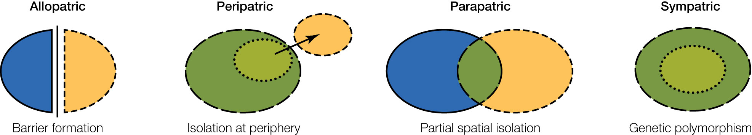
Figure 4.12 Four modes of speciation. Ovals with different colors and outlines represent distinct populations.
Notes:
Figure 4.12 Four modes of speciation. Ovals with different colors and outlines represent distinct populations.

Slide 20
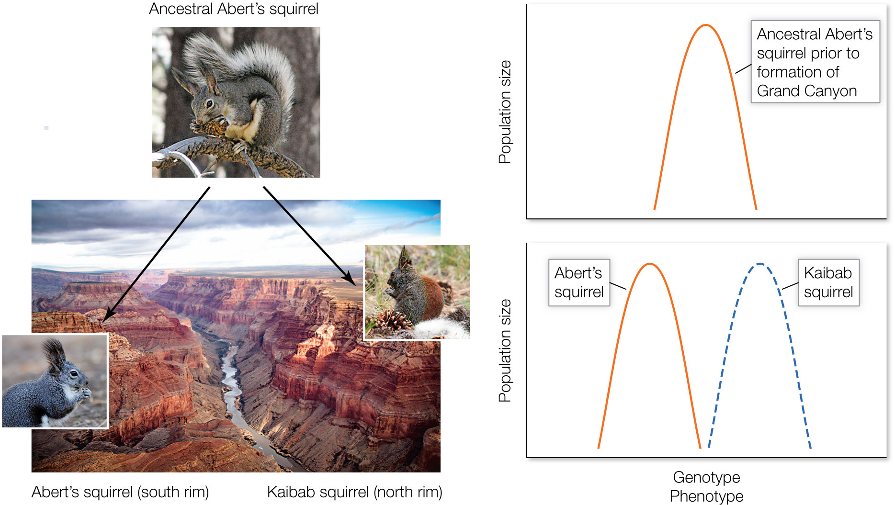
Figure 4.13 An example of allopatric speciation (geographic isolation).
Notes:
Figure 4.13 An example of allopatric speciation (geographic isolation). Before the Colorado River cut open the Grand Canyon, a single population of Abert’s squirrels existed, with individuals having similar genotypes and phenotypes. After the Colorado River formed the Grand Canyon, the single population of Abert’s squirrels was split into two groups. On the north rim, the Kaibab squirrel evolved. On the south rim, Abert’s squirrel evolved. These two groups are now biologically distinct species with different genotypes and phenotypes.

Slide 21
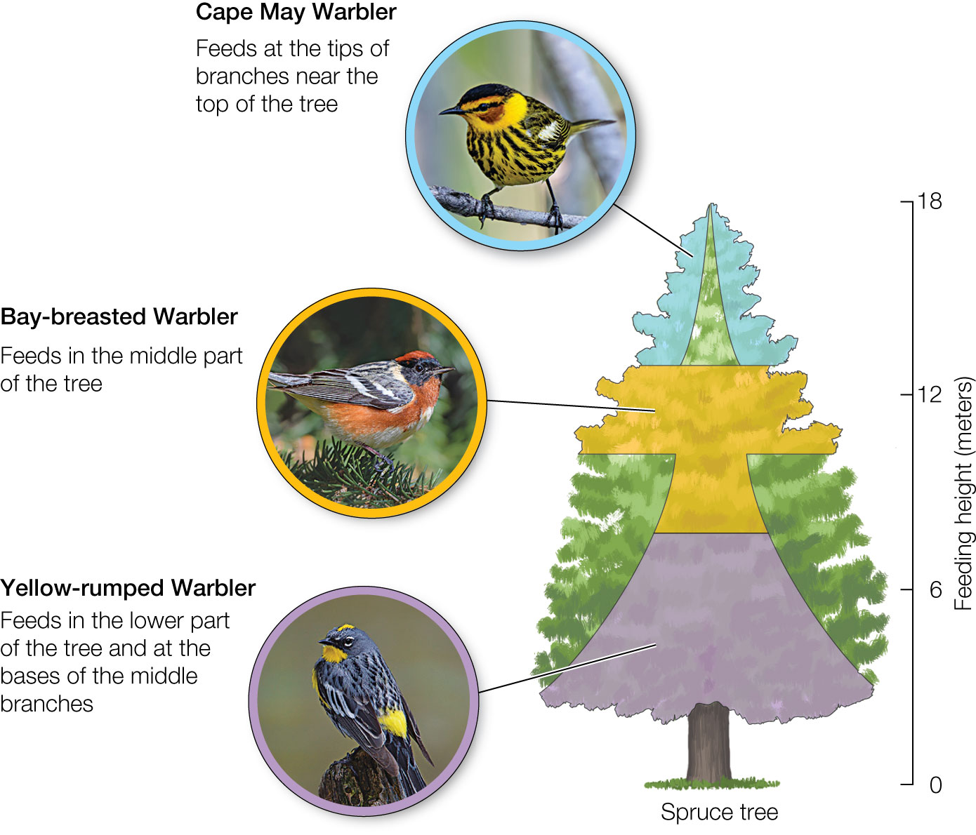
Figure 4.14 An example of niche partitioning among warblers that search for insects and nest in different parts of the same tree species. Niche partitioning reduces competition for food and reproductive sites, allowing the species to coexist.
Notes:
Figure 4.14 An example of niche partitioning among warblers that search for insects and nest in different parts of the same tree species. Niche partitioning reduces competition for food and reproductive sites, allowing the species to coexist.

Slide 22
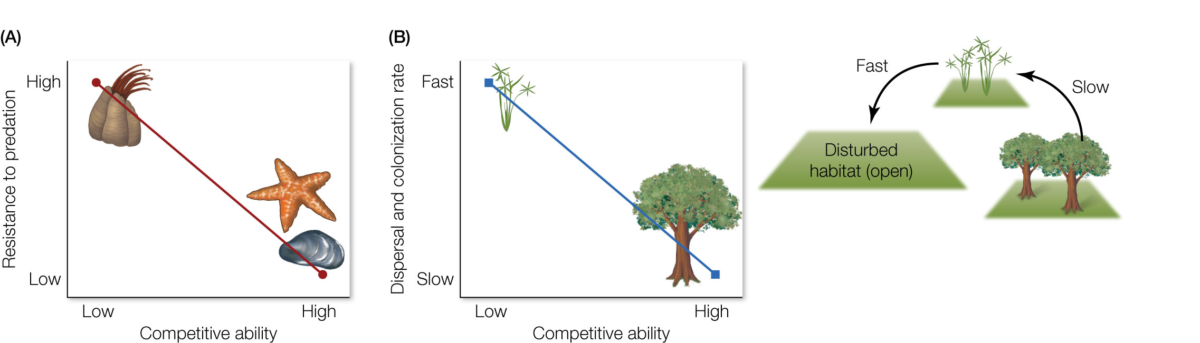
Figure 4.15 Examples of how life history trade-offs allow coexistence and enhance biodiversity.
Notes:
Figure 4.15 Examples of how life history trade-offs allow coexistence and enhance biodiversity. (A) The barnacle and the mussel coexist because of a competition–predation trade-off. The more competitive species for space (the mussel) is less resistant to predation by the sea star. As sea stars eat mussels, this opens up space for the less competitive barnacles. Therefore, the less competitive barnacles can coexist so long as they are more resistant to predation. (B) The tree and the weed coexist by a competition–dispersal tradeoff. The tree is more competitive than the weed and will take over space if given enough time. But the weed can coexist with the tree so long as it has a higher rate of dispersal that allows it to colonize open habitats before the tree arrives and takes over through competition.

Slide 23
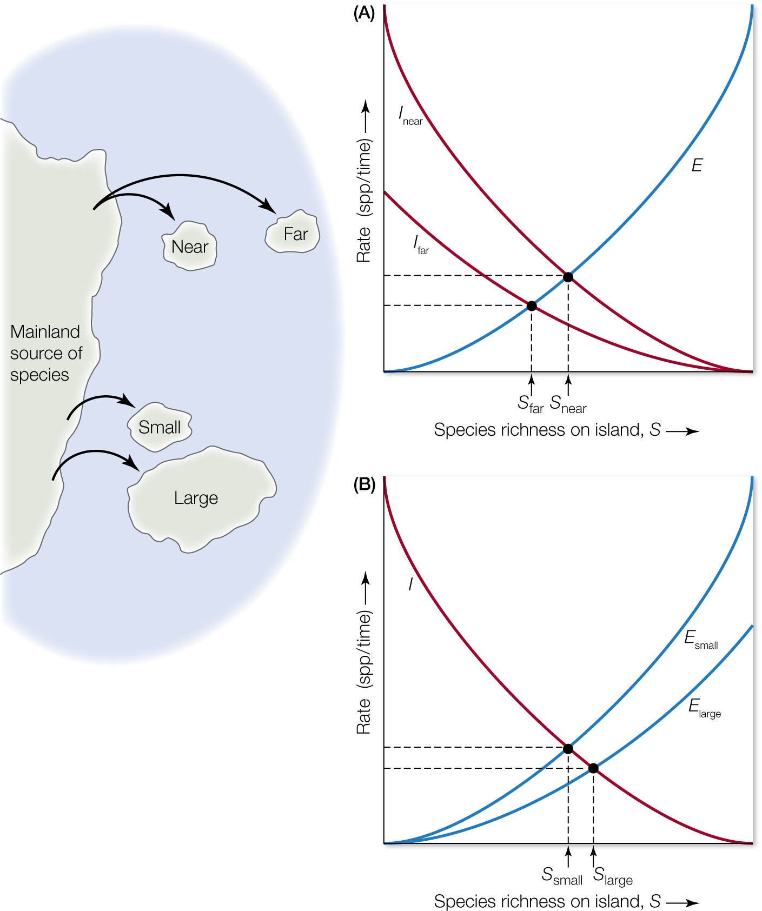
Figure 4.16 Island biogeography theory (IBT). IBT predicts that for islands of equal size (A), those farther from a mainland source of species will have lower rates of immigration, I.
Notes:
Figure 4.16 Island biogeography theory (IBT). IBT predicts that for islands of equal size (A), those farther from a mainland source of species will have lower rates of immigration, I. Lower rates of immigration lead to a lower equilibrium number of species on the island (dot labeled S_{far}), assuming extinction rates, E, remain the same. IBT further predicts that for islands that are equidistant from a mainland source of species (B), extinction rates will be greater for small islands because they have smaller population sizes. High extinction rates reduce the equilibrium number of species on the island (dot labeled S_{small}).

Slide 24
TABLE 4.3 Evolutionary and ecological processes that control changes in biodiversity
Driver of change | Increase diversity | Decrease diversity
Evolutionary
Mutation | ✓
Recombination | ✓
Speciation | ✓
Natural selection |  | ✓
Genetic drift |  | ✓
Ecological
Adaptive radiation | ✓
Competition |  | ✓
Predation and disturbance | ✓ | ✓
Dispersal and colonization | ✓ | ✓
Notes:
TABLE 4.3 Evolutionary and ecological processes that control changes in biodiversity

